Slide 1
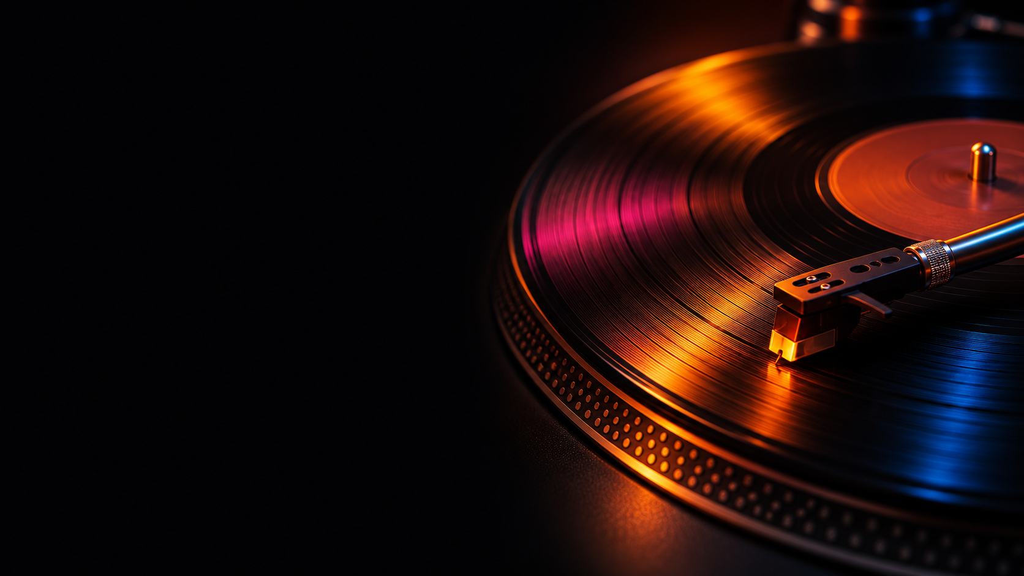
SUNO
A genre-mixing
experiment
Four tracks made with AI
01

Slide 2
What is Suno?
An AI music tool
Suno generates songs and instrumentals from text prompts. You can describe a mood, genre or arrangement and supply your own lyrics.
A web app
Create and listen in your browser. Suno’s servers run the music model and return an audio track to your Library.
A tool for mashups
Use existing tracks as sources and give Suno directions about what to combine. Listen back and choose which take to keep.
Our experiment
We used Suno to explore combinations of genres that we rarely hear in the same track.
02
Notes:
Sources (accessed November 4, 2026)
https://suno.com/blog/introducing-v6
https://help.suno.com/en/articles/13924481
https://help.suno.com/en/articles/2415873

Slide 3
Web setup and hardware
01 Open Suno
Visit suno.com/create on a laptop or phone with internet access.
02 Sign in
Continue with a listed provider or phone number. Use the Free plan for the class demo.
03 Open Create
Select Custom and choose v6-mini in the model menu. Simple mode uses one description field.
Hardware
Use a browser and speakers or headphones. A mic is optional. Suno runs generation remotely, with no local GPU or installation required.
Access verified through sign-in. The remaining steps follow Suno’s documentation.
03
Notes:
The public Create sign-in page and Explore page were accessed. The authenticated steps are documented but were not run for this presentation.
Sources (accessed November 4, 2026)
https://suno.com/create
https://suno.com/explore
https://help.suno.com/en/articles/2415873
https://help.suno.com/en/articles/13924801

Slide 4
Plan costs and downloads
FREE
PRO
PREMIER
US$0
US$10 / mo
US$30 / mo
50 credits per day
v6-mini access
No song downloads
US$96 per year
2,500 credits per month
20 downloads per month
US$288 per year
10,000 credits per month
60 downloads per month
Includes Suno Studio
The four demo tracks are embedded on slide 9.
Listed US rates checked November 4, 2026. Taxes and local pricing may vary.
04
Notes:
Sources (accessed November 4, 2026)
https://suno.com/pricing?pos=hero
https://suno.com/hub/ai-music-software

Slide 5
How Suno generates music
Your browser
→
Suno’s servers
→
Your Library
Style, lyrics and
optional audio
Hosted v6-family
music generation
Audio playback,
selection and edits
Suno offers v6, v6-wild and v6-mini. Its public v6 materials do not disclose whether the music models use transformers, diffusion or a hybrid, or which hardware or outside APIs they use.
Suno’s separate open-source Bark model uses transformers for text-to-audio. Bark’s design does not establish how v6 works.
05
Notes:
Sources (accessed November 4, 2026)
https://suno.com/blog/introducing-v6
https://help.suno.com/en/articles/13924801
https://github.com/suno-ai/bark

Slide 6
How Suno trains its music models
1. Gather examples
Suno reports using tens of millions of publicly accessible music files and related text metadata. Some recordings may be copyright-protected.
2. Prepare the data
Suno organizes, cleans, and filters the collected data before training to remove low-quality material.
3. Learn from audio and text
The examples help the model connect descriptions, such as genres, with how the music sounds. Suno says some later training datasets may also include user content and activity.
What v6 leaves open
Suno describes its data sources at a high level. Its public materials leave the exact v6 dataset, architecture, and training procedure unspecified.
Source: Suno’s California training-data disclosure and v6 announcement.
06
Notes:
Sources (accessed November 4, 2026)
https://help.suno.com/en/articles/9709569
https://suno.com/blog/introducing-v6

Slide 7
The prompt is the main control
What we specify
Style, mood, instrumentation and lyrics. For a mashup, we also choose the source tracks and adjust the sliders.
What we decide
Which take to keep, what to change in the prompt, and whether to regenerate or edit a section.
Easy to explore
Hear a complete arrangement quickly and compare multiple treatments of the same idea.
Hard to control
Exact notes, bar counts and syllable timing. The generated track starts as a single mix.
07
Notes:
Sources (accessed November 4, 2026)
https://help.suno.com/en/articles/2415873
https://help.suno.com/en/articles/2417409
https://help.suno.com/en/articles/6141505

Slide 8
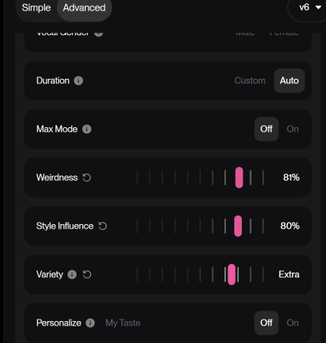
Our genre-mixing experiment
Could Suno blend styles we rarely hear together?
We tried combining mariachi, Latin pop, orchestral music, rock, Afrobeats, big band and EDM across four tracks.
We mostly used Mashup, pairing tracks and changing Weirdness, Style Influence and Variety to explore different blends.
Listen for what carries over from The Final Stand into the final mashup.
One settings example from the experiment
08
Notes:
We wanted to hear how genres that rarely appear together would sound in one track. We used one standalone generation and three mashups. This screenshot documents one example in v6 Advanced: Weirdness 81%, Style Influence 80%, Variety Extra, Duration Auto, Max Mode Off, and Personalize Off. Exact settings for individual tracks are not recorded here. Suno says Variety can adjust the style prompt. Compare the standalone track with the final mashup and point out one audible change.
Source for Variety: https://help.suno.com/en/articles/13924481

Slide 9
Listen to the four tracks
▶
01
The Final Stand
▶
02
Mariachi Techno × Raise It Up (Mashup)
▶
03
Raise It Up, Pass It Around × Bri… (Mashup)
▶
04
Mariachi Techno × Raise It Up × The Final Stand (Mashup)
Select a play icon in Slide Show to hear its track.
09
Notes:
Four supplied MP3s are embedded. Titles are shortened for readability. Compare an excerpt from The Final Stand with an excerpt from the final mashup. We can share our exact prompts, model and plan if available.

Slide 10
Failure cases and output bias
Prompt drift
Listen for missing instruments, an unexpected voice, or a transition that lands too early or late.
Audio artifacts
Check for garbled words, smeared instruments, abrupt endings or audible seams after an edit.
Genre and language bias
Test whether the model falls back on genre clichés or handles accents, languages and regional styles unevenly.
A small comparison
Reuse the prompt and change one instruction. Compare two takes for prompt fit, clarity and unexpected changes.
These are listening tests. Add an observed example and timestamp after generation.
10
Notes:
Sources (accessed November 4, 2026)
https://help.suno.com/en/articles/13924801
https://help.suno.com/en/articles/6141505
https://help.suno.com/en/articles/2417409

Slide 11
Model and output rights
Model access
The v6 music models are offered as a hosted service. The separate Bark project has an MIT license.
Free output
Suno limits free output to lawful personal, noncommercial use. The current Free plan lists no song downloads.
Paid output
Pro and Premier can commercially use eligible output via an approved download, subject to the terms. Suno does not guarantee copyright.
Your inputs
Submit lyrics and audio you have rights to use. Suno’s terms grant it a broad license, including use for model improvement.
11
Notes:
Sources (accessed November 4, 2026)
https://suno.com/terms
https://suno.com/pricing?pos=hero
https://github.com/suno-ai/bark

Slide 12
Privacy and security
What Suno receives
Prompts, lyrics, files and recordings you submit, plus account, device and usage information.
Where it goes
Suno processes it on its service. Its policy describes sharing with service providers and use for service improvement.
Device access
A text-only run needs no microphone. Recording uses the mic if you grant access. Uploading sends the file you select.
Who can listen
Anyone with the Link-Only URL can open the song. Use original text and leave sensitive recordings out of the demo.
12
Notes:
Sources (accessed November 4, 2026)
https://suno.com/privacy
https://suno.com/terms
https://help.suno.com/en/articles/9601601

Slide 13
A soundtrack for our final project
Where it fits
Use Suno to audition mood and instrumentation for a short video or interactive scene.
What we would add
Edit the cue to picture or make a clean loop in an audio editor. Keep a record of the prompt, model and rights.
What could go wrong
Music may miss a cue, compete with dialogue, or be difficult to loop. Download and usage rights depend on the plan.
What we would test
Play it in the project. Check timing, dialogue clarity and whether the intended release needs commercial rights.
Example application for our group’s final project.
13
Notes:
A short video or interactive scene is an example because the actual final project is unspecified.
Sources (accessed November 4, 2026)
https://suno.com/terms
https://suno.com/pricing?pos=hero

Slide 14
Can students train a model?
Suno’s public API
The documented API checks whether audio carries Suno’s content credentials. We found no public API for training or fine-tuning Suno.
Custom Models in Suno
Pro and Premier users can upload at least six songs they have the rights to use. Suno handles training and keeps the custom model private.
Training with code
Meta’s AudioCraft MusicGen publishes training code and noncommercial model weights. Use recordings you have permission to train on.
A project experiment
Compare the base and fine-tuned MusicGen models using the same genre-mixing prompts. Listen for which genre cues carry through.
Our four demo tracks are below Suno’s six-song minimum.
14
Notes:
Sources (accessed November 4, 2026)
https://suno.com/suno-credentials
https://help.suno.com/en/articles/11362497
https://github.com/facebookresearch/audiocraft/blob/main/docs/MUSICGEN.md
https://github.com/facebookresearch/audiocraft/blob/main/model_cards/MUSICGEN_MODEL_CARD.md

Slide 15
Sources
Setup and models
Suno Create, Suno Help Center and Introducing v6
Plans and editing
Suno Pricing, pricing explainer and Song Editor documentation
Architecture example
Suno’s Bark repository on GitHub
Rights and privacy
Suno Terms of Service, Privacy Notice and Free Plan Help Center
Source links are in the speaker notes. Accessed November 4, 2026.
15
Notes:
Sources (accessed November 4, 2026)
https://suno.com/create
https://suno.com/blog/introducing-v6
https://suno.com/pricing?pos=hero
https://suno.com/hub/ai-music-software
https://help.suno.com/en/articles/6141505
https://github.com/suno-ai/bark
https://suno.com/terms
https://suno.com/privacy
https://help.suno.com/en/articles/9601601

